Slide 1


BrisPUG

Slide 2
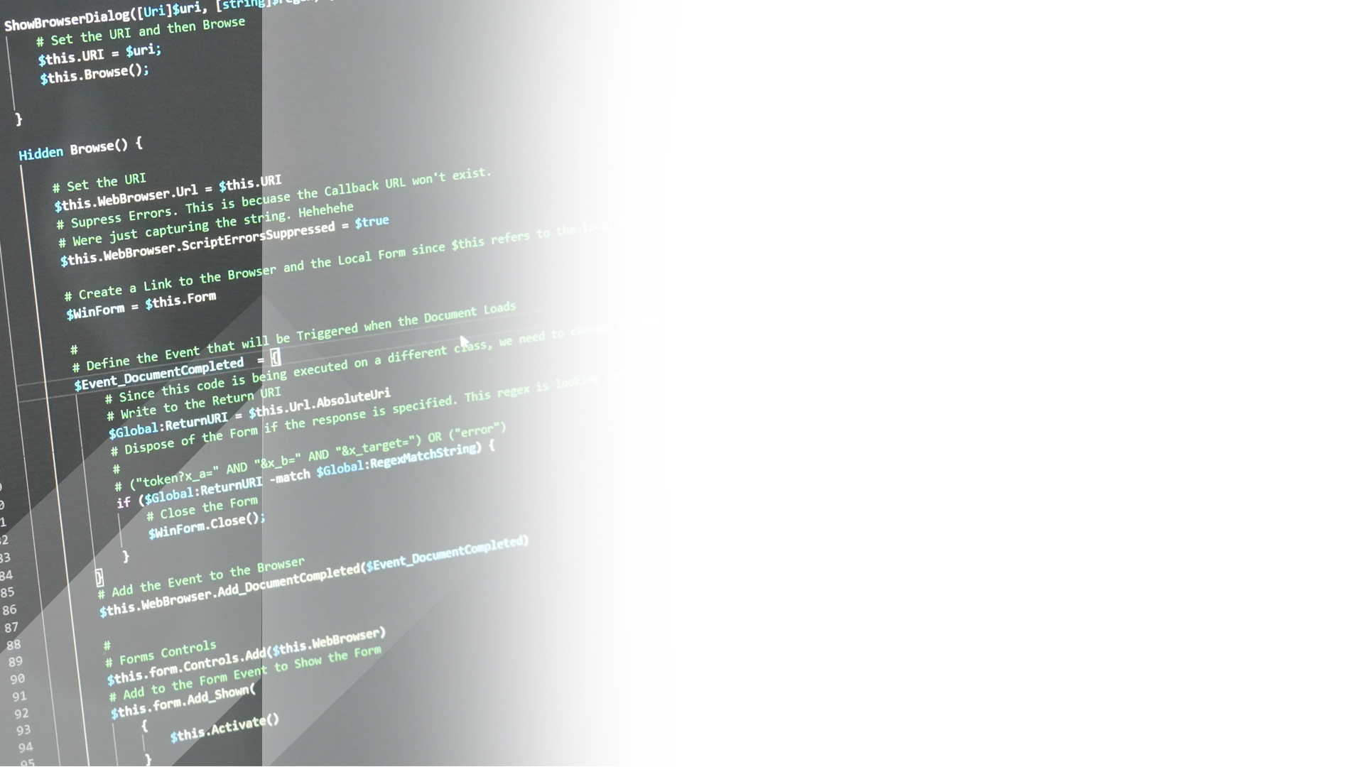

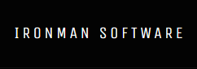

Sponsored By:

Slide 3

PowerShell
News

Slide 4
Windows Terminal (Preview) is now available in the Windows Store
PowerShell shown running on Android using UserLAnd
DSC will continue as Azure Policy Guest Configuration

Slide 5
Module of the
Month

Slide 6


PoshBot
https://github.com/poshbotio/PoshBot
Chatbot written in PowerShell
Enables ChatOps
Available for Slack and Teams
PowerShell Summit 2018 talk: https://youtu.be/Mrs49IdnSHc demo: https://youtu.be/36fkyKYq43c?t=1472
Notes:
Check out: "\Sessions\22nd - January - 2019\Demos\Pester Tests.ps1"

Slide 7
Scripting
Games

Slide 8
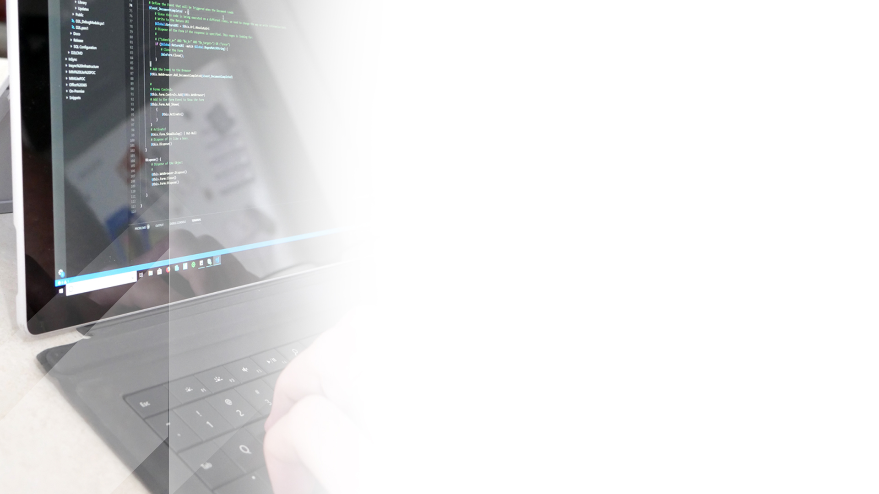
Create a Rubik Cube Solver Using PowerShell. Extra Points for a Graphical Solver.
Submissions to the #scripting-games slack channel.
Winner randomly selected at the next meeting

Slide 9
PowerShell Ignite Talks
OAuth 2.0, 101 Ways to Run Exe’s, PS & Bitlocker

Slide 10
OAuth 2.0 Rundown

Slide 11

What is OAuth 2.0 (RFC 6749)?
• Authentication Framework (RFC 6749)
• Allows Limited Access to a HTTP service.
• Supersedes OAuth 1.0
• Username / Password is exchanged by a tokens.
• Access lists is defined using Scopes.

Slide 12

OAUTH 2.0 PROCESS
Setup Access
Request Authorization Code
Request Access Token
Use Service with Access Token
Request Access Token Refresh
Notes:
Setup Access – Connect to the Application Endpoint and Enable Access define the scope of the permissions. The application will issue an Application Id / Client ID & Client Secret.
You now must get an Authorization Code. The authorization code is used by the application to verify that consent has been given by the application.
Once you have the Authorization Code. Using the Client ID, Secret, Scope and Code you can exchange it for an Access Token.
The access token is used for all API requests under the Authorization HTTP header.
When the access token is expired, a new token can be requested by exchanging the refresh token for a new access token.

Slide 13
Demo

Slide 14
SCOPES FAQ’S
Mechanism to limit application access to a user account.
Denoted by “action:location” – read:profile
Scopes must be specified in exchange for Token.

Slide 15
ACCESS TOKENS FAQ’S
They have a limited lifetime. (You can adjust the lifetime of the token)
Most are signed using JWT or Other Protocol
They still are passwords and should be treated as such.

Slide 16
JWT (JSON WEB TOKEN) (RFC 7519)
Representative claims securely between two parties.
Plaintext / Encrypted Component
(PlainText –ne Encrypted) {return $false}
Notes:
Json Web Token is a lightweight means of representing claims between two parties. In Oauth 2.0 it is used to validate the integrity of the Access Token. This is done when the server (“the issuer”) sends the token. Since it has issued the token using a private key, it can be validated
There is a plaintext and encrypted components. The plaintext is predominantly used and the encrypted component is used for verification.
When validating the authenticity of the payload, the server will check against the encrypted component using it’s private key. If they are different, then the token is different.

Slide 17
JWT Demo
Notes:
https://jwt.io/

Slide 18
Oauth 2.0 Demo

Slide 19
Questions?

Slide 20
USEFUL LINKS
https://tools.ietf.org/html/rfc6749.html
https://tools.ietf.org/html/rfc7519
https://jwt.io/

Slide 21
101 Way’s to Run EXE’S

Slide 22
Call Operator
Super simple
Harder to capture and manage output
Simply call the executable 'whoami.exe'
Or use the call operator '&$exe'

Slide 23
Start-Process
Proper PowerShell cmdlet
Offers some low level options
Cumbersome to capture output

Slide 24
System.Diagnostics.Process
Like Start-Process but the fundamental .NET class it uses underneath
Some more control than Start-Process
Can capture output to a var
A bit verbose

Slide 25
ShellExecute
COM!
Simple but with few options

Slide 26
Win32_Process Create
Uses WMI to start the process
Even more control over starting the process
Hard to capture the output

Slide 27
PInvoke - CreateProcess*
Low level, proper Win32 API that is used to start a process
Different functions to start a process as another user
Quite complex

Slide 28
Escaping Arguments
Close to black magic
Basically " is the only special char
\ only matters if preceding "
Win32 rules != cmd rules
Cmd has a whole bunch of meta chars

Slide 29
Demo

Slide 30
USEFUL LINKS
Exe demos - https://github.com/jborean93/brispug-repo/tree/master/processes
https://blogs.msdn.microsoft.com/twistylittlepassagesallalike/2011/04/23/everyone-quotes-command-line-arguments-the-wrong-way/

Slide 31
PS BitLocker

Slide 32
Links

Slide 33
Questions?

